Slide 1
Predicting the Magnitude of Earthquakes
By: Ryan Barry, Brian Farrell, Jacob Pacheco
Notes:
Ryan - Data retrieval and preprocessing, Linear Regression, KNN
Brian - Prior research, Neural Network, Conclusion, Future Work
Jacob - Decision Tree, Random Forest, Slides Quality Control

Slide 2
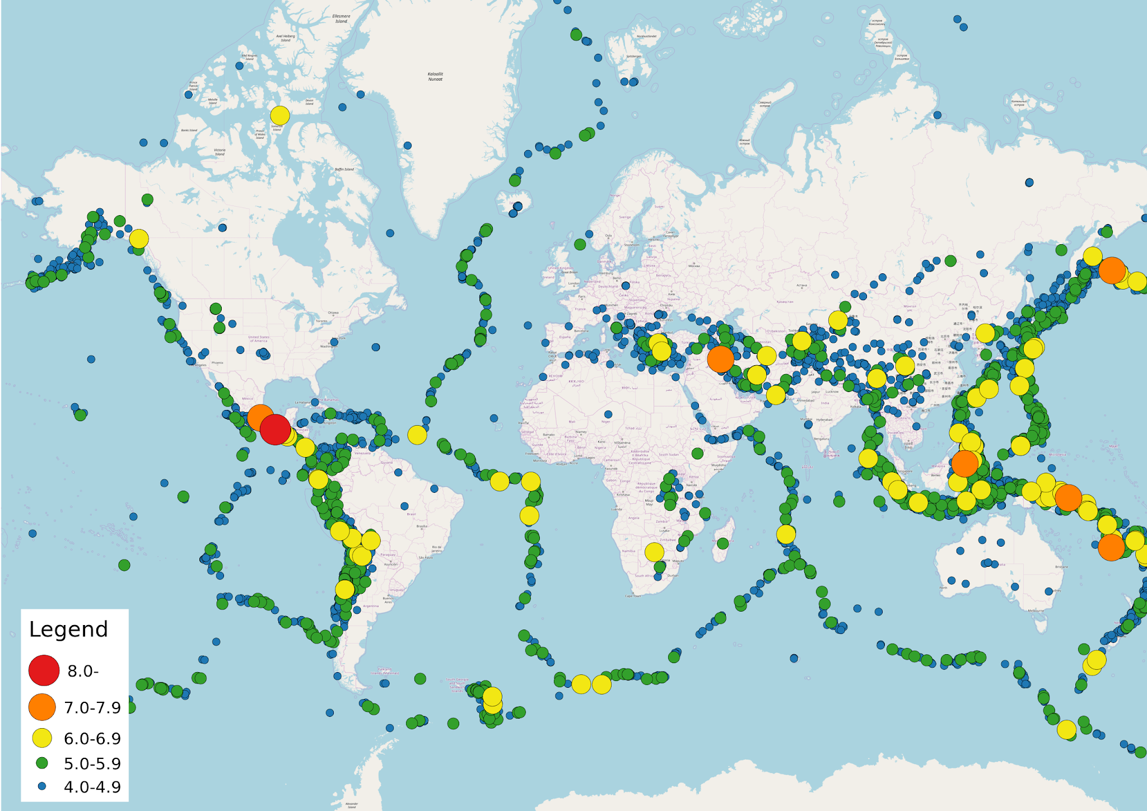
Why This Project?
Humanitarian Impact
Real-World Application
Apply Learned Techniques
Notes:
Highlight the potential to save lives and minimize destruction by predicting earthquakes magnitudes.
We wanted the opportunity to apply machine learning in a practical setting by predicting natural disasters.
Wanted to choose a project that allowed us to apply the most amount of techniques that we learned in class during the project

Slide 3
Previous Research
A Machine Learning Approach for Earthquake Magnitude Estimation
Earthquake magnitude prediction in Hindukush region using machine learning techniques
Medium-large earthquake magnitude prediction in Tokyo with artificial neural networks

Slide 4
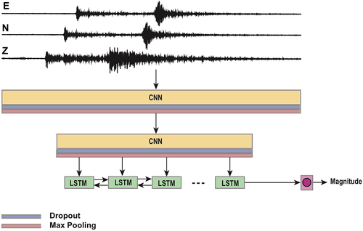
A Machine Learning Approach for Earthquake Magnitude Estimation
S. Mostafa Mousavi and Gregory C. Beroza
Notes:
Training - 300,000

Slide 5
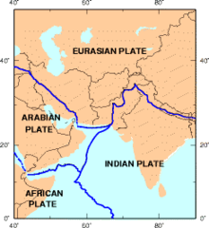
Magnitude Prediction in Hindukush Region
By: Asim, Martínez-Álvarez, Basil and Iqbal
Random Forest: 62%
Pattern Recognition NN: 58%
RNN: 64%
Linear Programming boost ensemble classifier: 65%

Slide 6
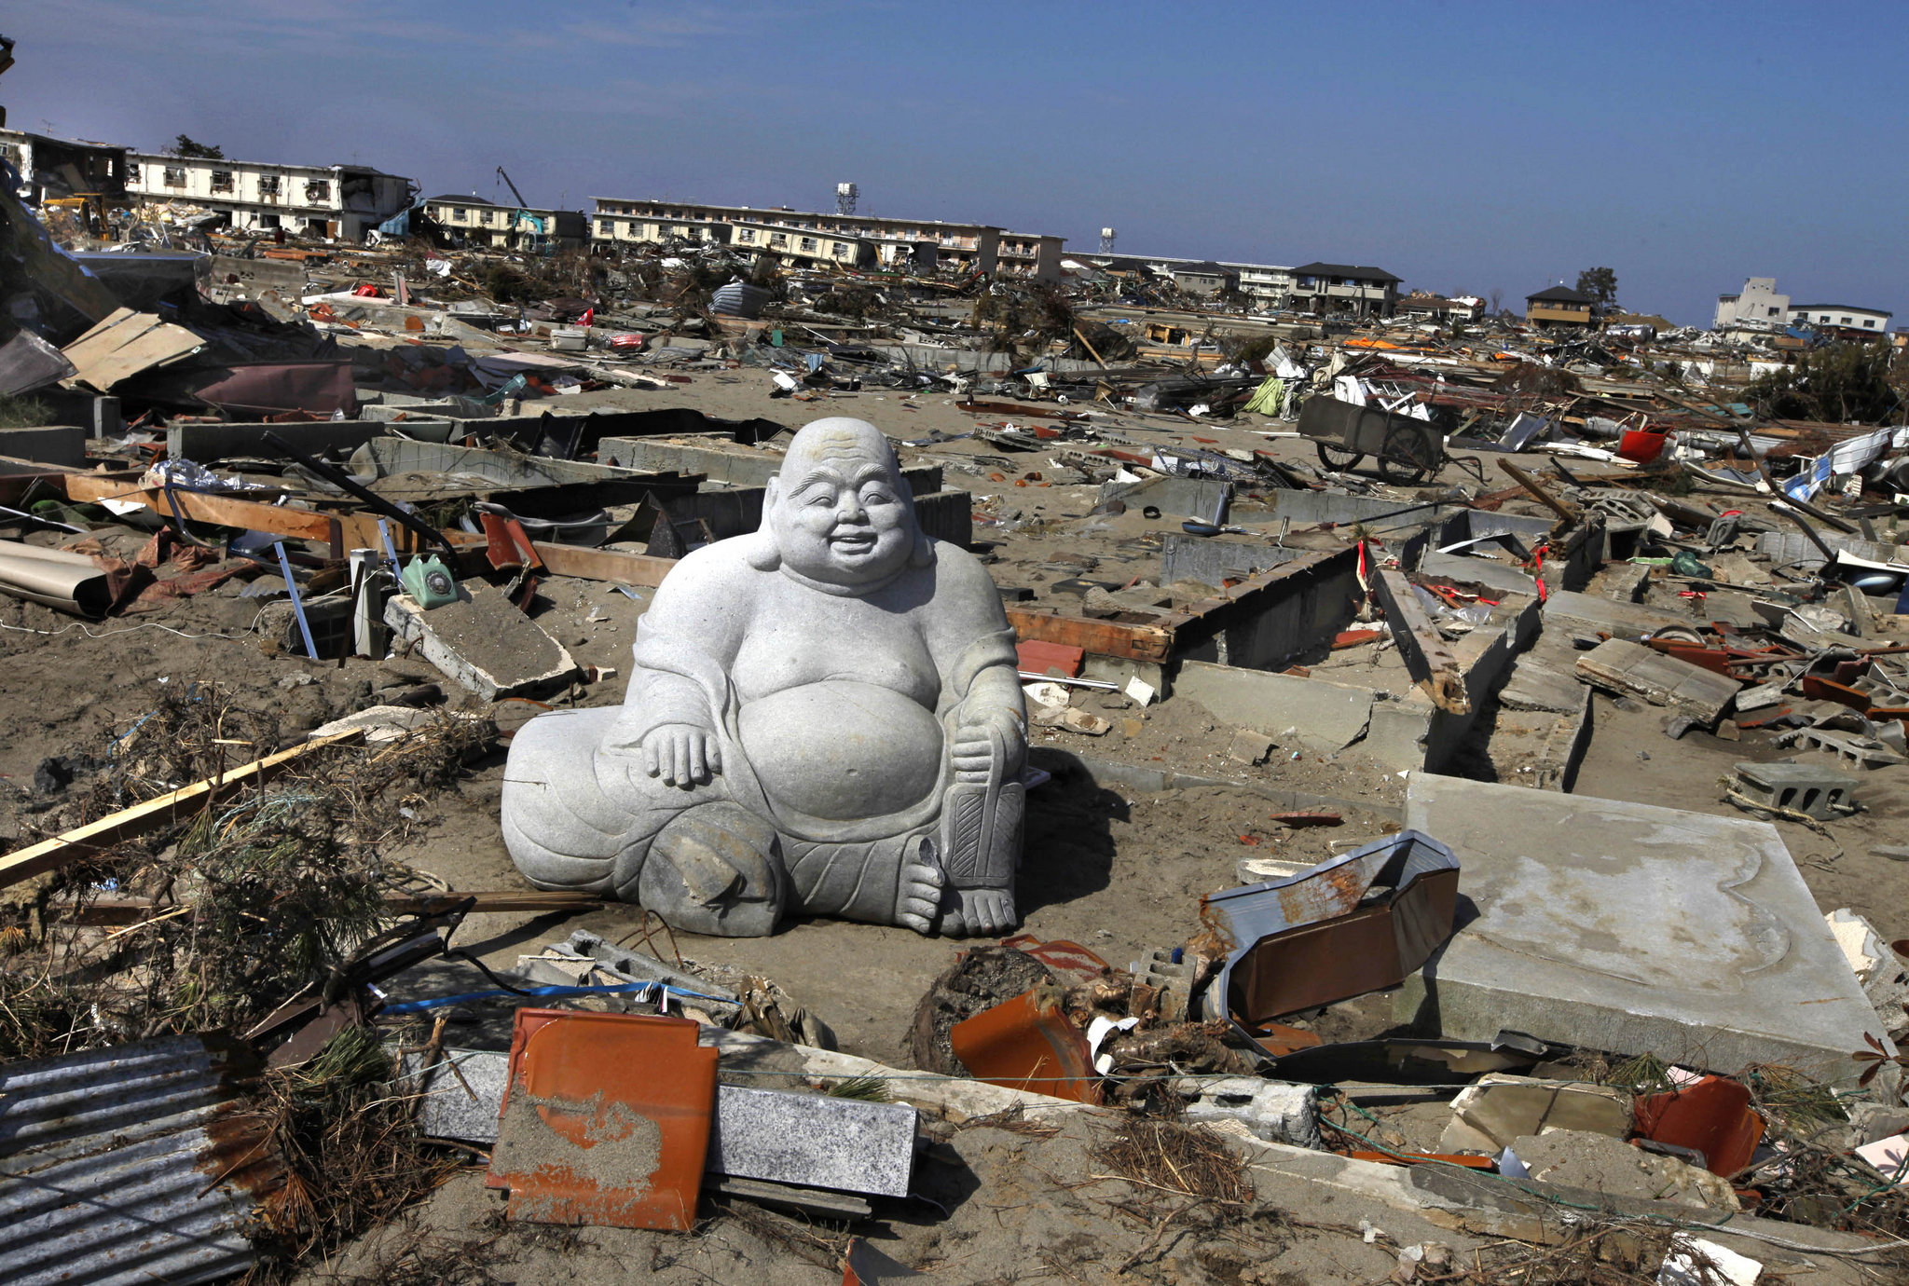
Medium-Large Earthquake Magnitude Prediction in Tokyo
Ascenio-Cortés, Martínez-Álvarez, Troncosco, and Morales-Esteban
Artificial Neural Network: 72%
KNN: 65%
SVM: 45%
Bayesian networks: 30%
Decision Trees: 37%

Slide 7

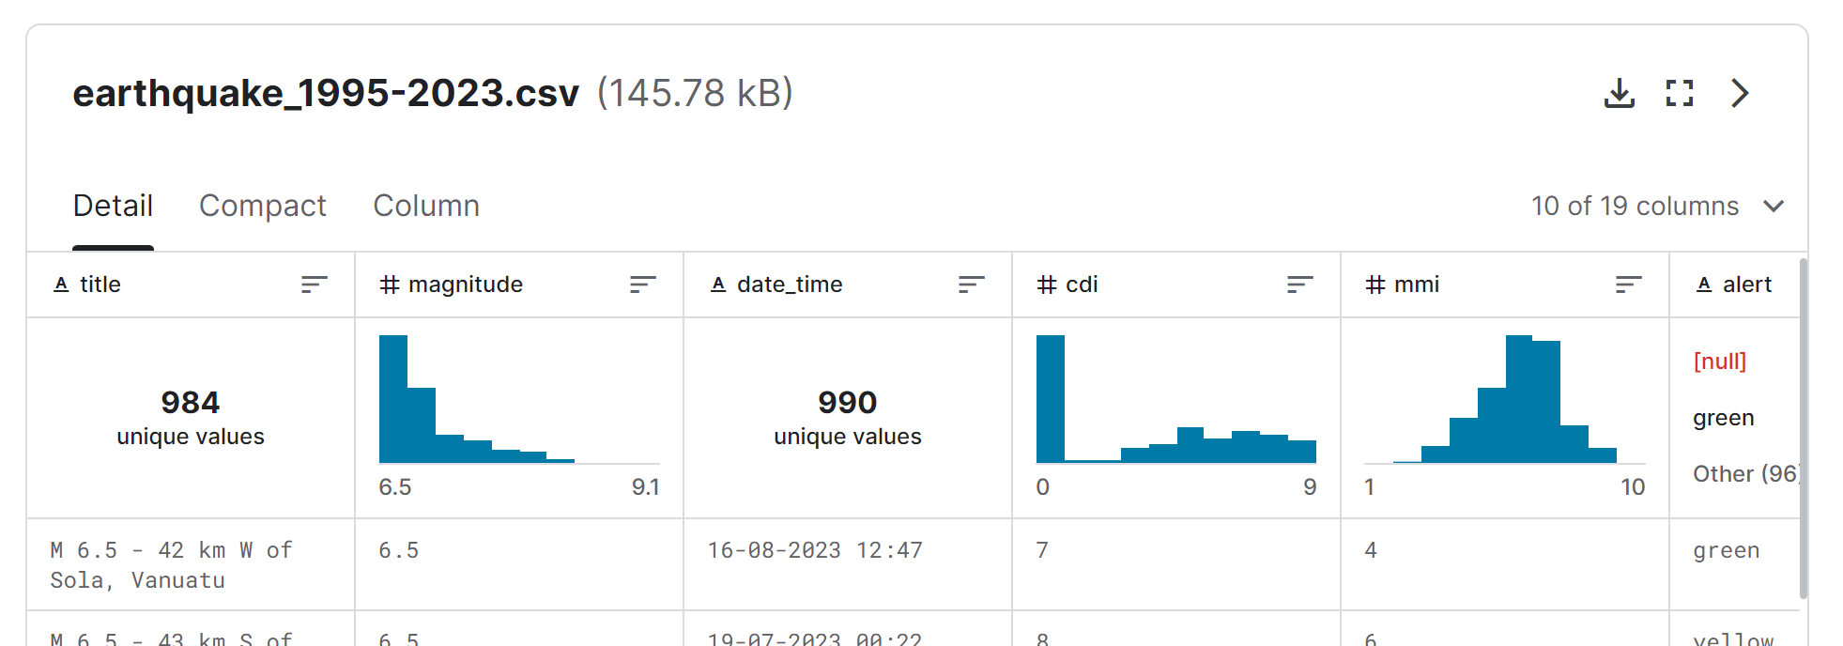
Retrieving the Dataset
Kaggle
United States Geological Survey
Scripting and API usage
for i in range(0000, 2023):
for j in range(1, 12):
if j < 10:
url = "https://earthquake.usgs.gov/fdsnws/event/1/query?format=csv&eventtype=earthquake&starttime=" + str(i) + "-0" + str(j) + "-01&endtime=" + str(i) + "-0" + str(j) + "-31"
else:
url = "https://earthquake.usgs.gov/fdsnws/event/1/query?format=csv&eventtype=earthquake&starttime=" + str(i) + "-" + str(j) + "-01&endtime=" + str(i) + "-" + str(j) + "-31

Slide 8
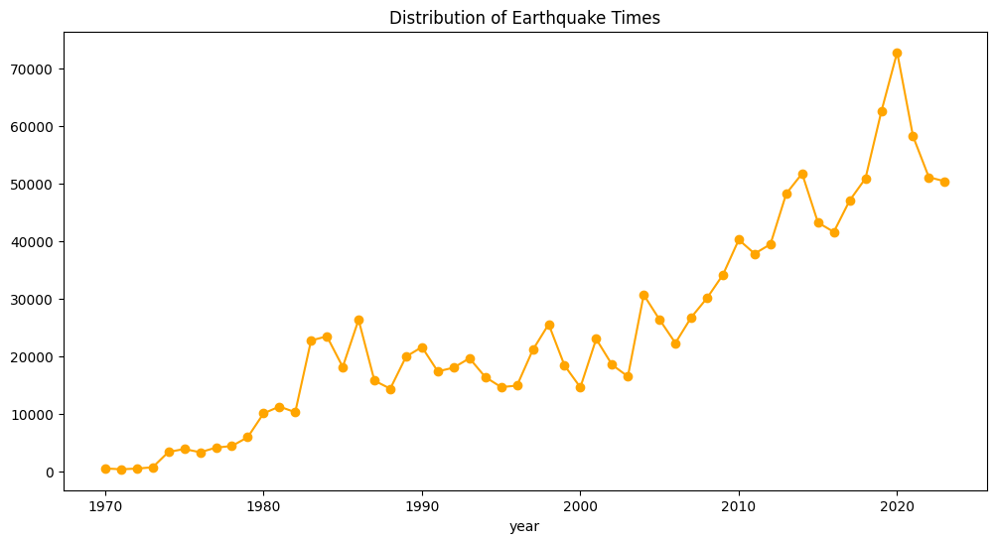
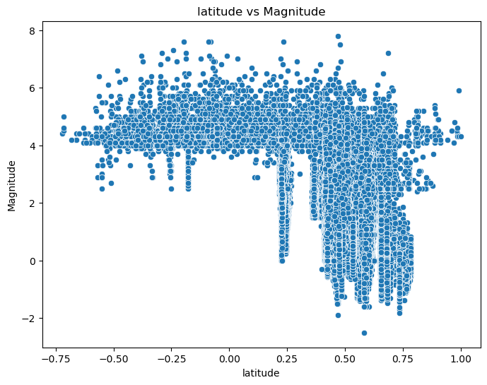
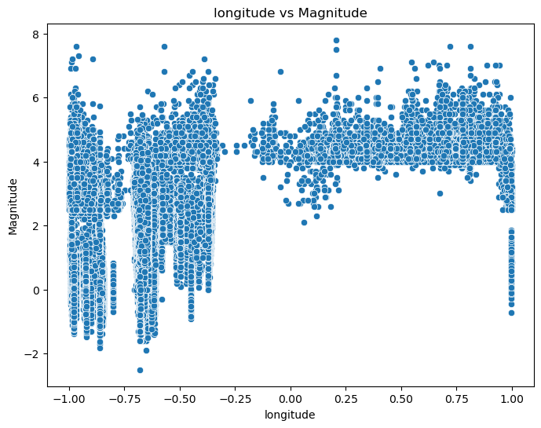
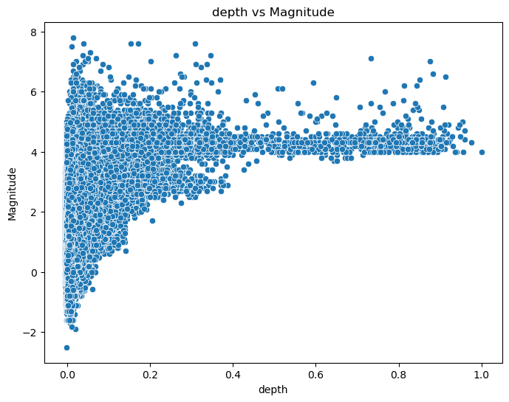
Preprocessing and Visualizations
Cleaning
Time Column
Standardization
Rounding

Slide 9
Our Models
Linear Regression
K-nearest Neighbor
Decision Tree
Good for Predicting a continuous numeric output based on the linear relationship between input and the target variable.
Good at Predicting the value of a new instance by averaging the values of its 'k' closest neighbors in the feature space.
Makes decisions by creating a tree-like structure based on feature values, enabling regression (in our case). Recursively splits the dataset into subsets by selecting the most significant feature at each node.
Random Forest
Neural Network
Constructs multiple decision trees using random subsets of data and features and combines their predictions to reduce overfitting and improve accuracy.
Learns complex patterns and relationships in data by simulating interconnected neurons organized in layers. Processes data through interconnected nodes, applying weighted inputs, activation functions, and layers to make predictions.

Slide 10
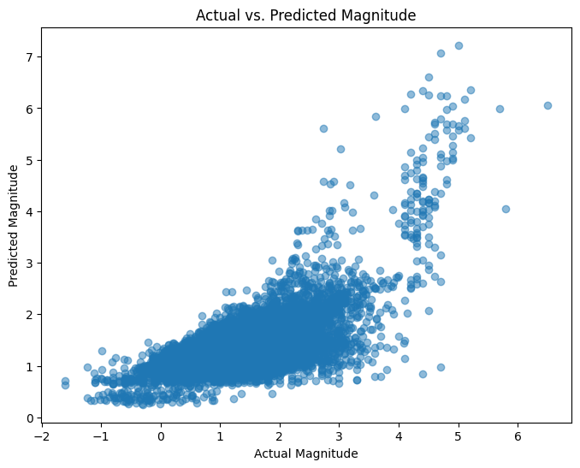
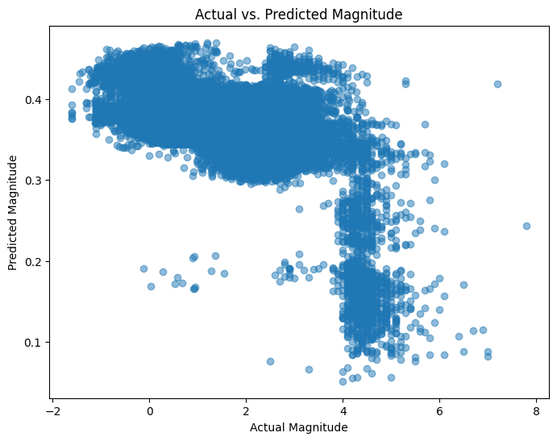
Multivariate Linear Regression
Gradient Descent
Model Coefficients: [-1.6703126 1.00552311 2.07141934 6.38327663 0.45242468 26.20542462 19.27907624 1.80200487 4.69176123 1.31130718 5.44093231]
Model Intercept: 2.0387302179535935
Mean Squared Error: 0.35879174450729834
R-squared (R2) Score: 0.4262320952176537
Gradient Descent: Coefficients: [ 0.09357594 -0.12917132 0.00361046 0.01213822 0.06916533 0.00033919 0.00058599 0.00129556 0.0007036 0.00581194 0.004832 ]
Intercept: 0.21411107205608038
Mean Squared Error: 1.4464787247926842
R-squared (R2) Score: -1.31316099085902
Notes:
Standardized dataset
During gradient descent many issues were met such as the coefficients diverging to infinity, the MSE and R-squared values going off out of their ranges. Tried changing the learning rate, epochs, using the SKlearn standardization and regularization function

Slide 11
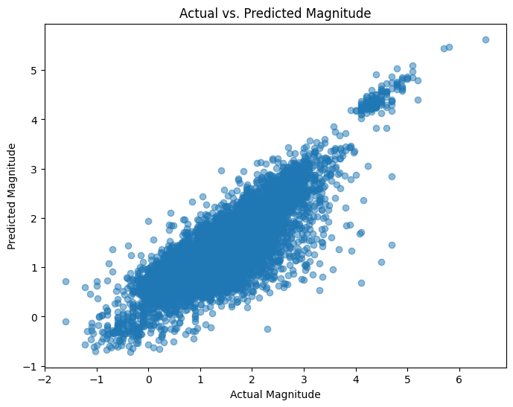
K-Nearest Neighbor
KNN Regressor
K: 16
Mean Squared Error: 0.1610922537727131
R-squared (R2) Score: 0.7387665477026122
K: 16
Mean Squared Error: 0.1610922537727131
R-squared (R2) Score: 0.7387665477026122
Notes:
Best results were from the non standardized dataset, using manhattan metric, and weights being distance.

Slide 12
Decision Trees
Functionality
Highlights
Classify magnitudes into categories by recursively splitting the dataset using the significant features
Train/Test split of 80/20
Relatively high accuracy metrics
Reveals importance of the seismic attributes
Working Principle
Drawbacks
Decision nodes are created based on seismic attributes
Splitting criteria are determined to segregate the magnitude ranges, identifying patterns in the data.
Potential overfitting and generalization
Limitations in handling seismic data

Slide 13
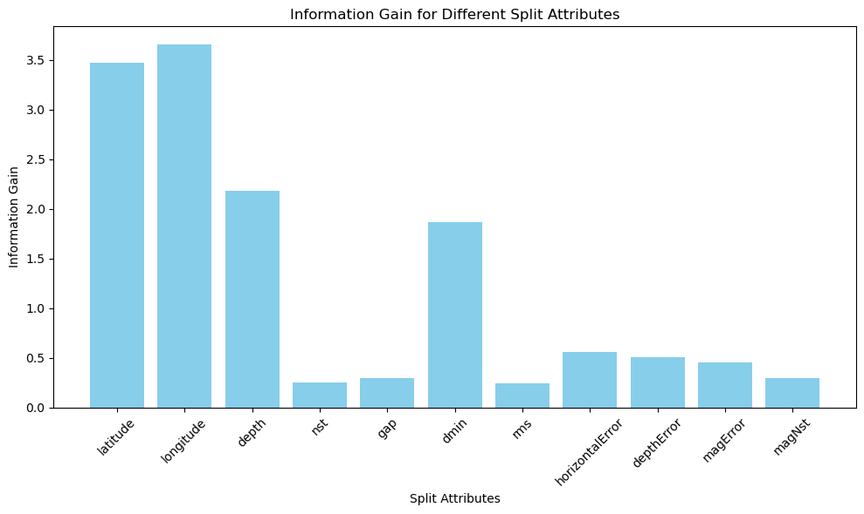
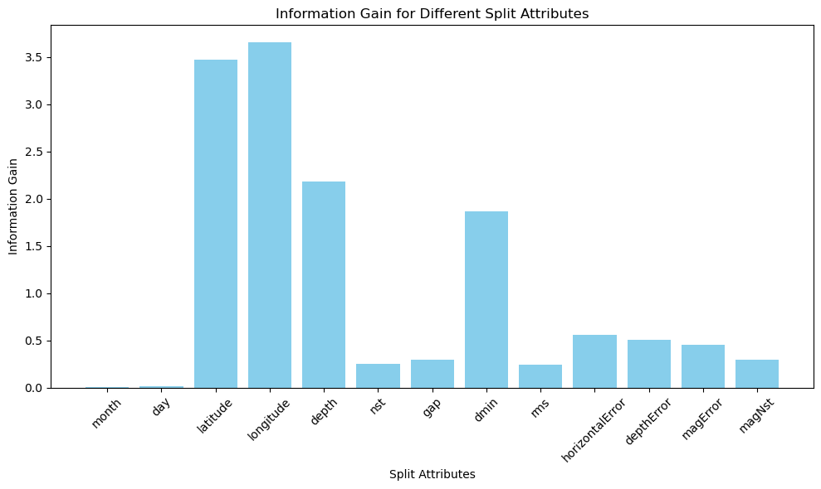
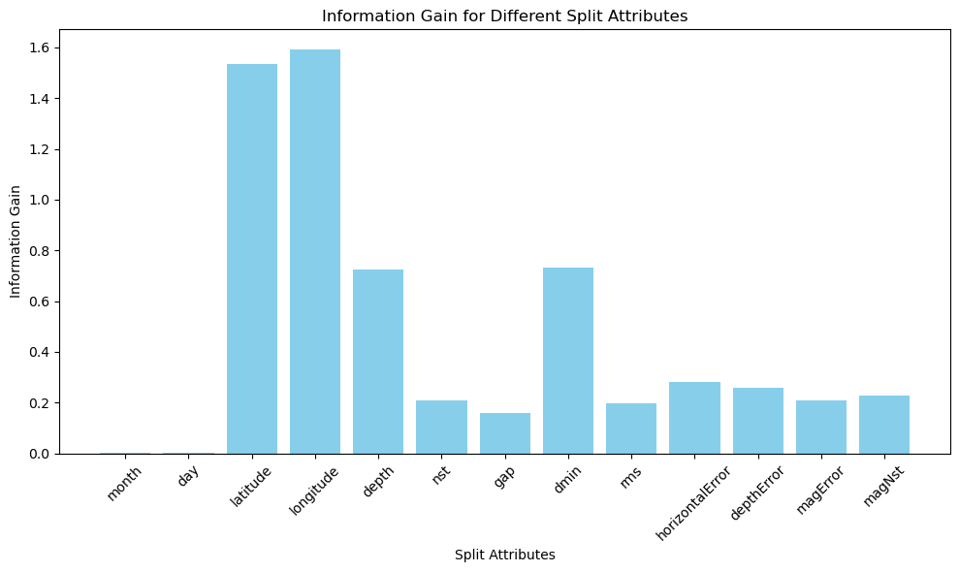
Decision Trees
 | Non-Standardized | Standardized | Standardized Rounded*
Mean Squared Error | 0.19445222790612568 | 0.1940149658389697 | 0.19392385366037448
R-Squared Score | 0.6897314584440116 | 0.6904291550727164 | 0.690647252107492
Information Gain
Non-Standardized
Standardized
Standardized Rounded
Notes:
What the gain means:
Latitude and Longitude have relatively high information gains, this lead us to believe that geographic coordinates are most essential in terms of predicting magnitudes.
Depth has a moderate information gain value suggesting that its somewhat useful in the predictions
nst, gap, rms, horizontalError, depthError, magError, and magNst have moderate to low information gains, this means that these features were not as effective in creating subsets that are prone to finding the correct magnitude
Month and Day had extremely low information gains indicating that they had no effect in the predicting the magnitude

Slide 14
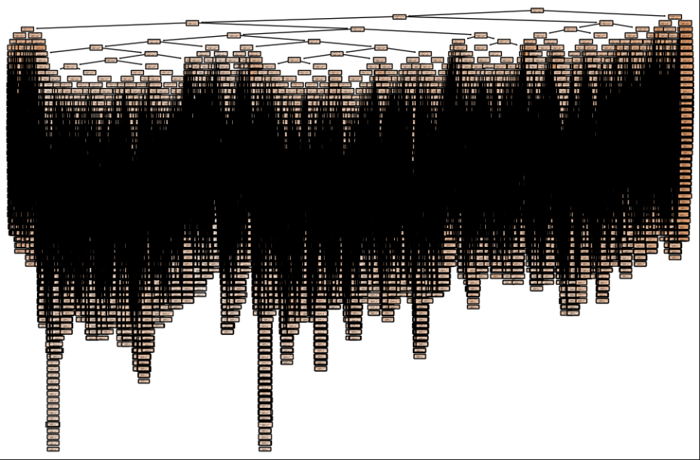
Decision Tree Visualization

Slide 15
Random Forest
Functionality
Advantages
Combine diverse decision trees' predictions for better accuracy and reduced overfitting.
Train/Test split of 80/20
Protects against overfitting due to the mixture of diverse trees.
Handles high-dimensional data and large datasets efficiently.
Offers better accuracy compared to decision trees.
Working Principle
Usage
Builds decision trees by using random subsets of both data samples and features.
Each tree contributes to the final prediction through a voting or averaging, reducing individual tree biases.
Suitable for regression problems
Effective in scenarios where overfitting might occur

Slide 16
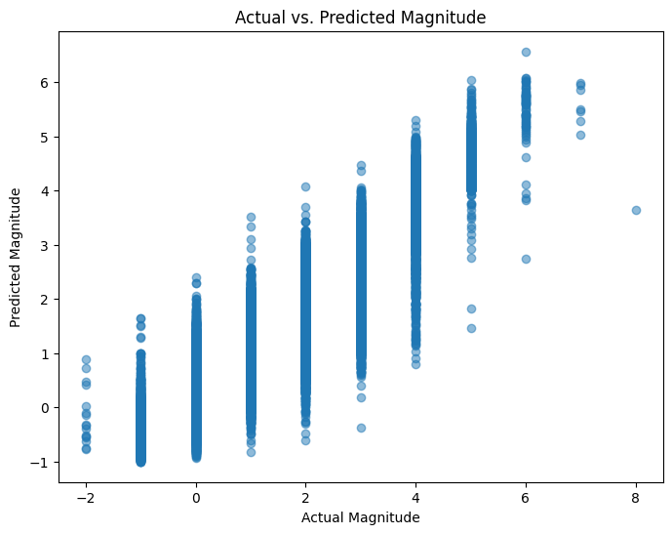
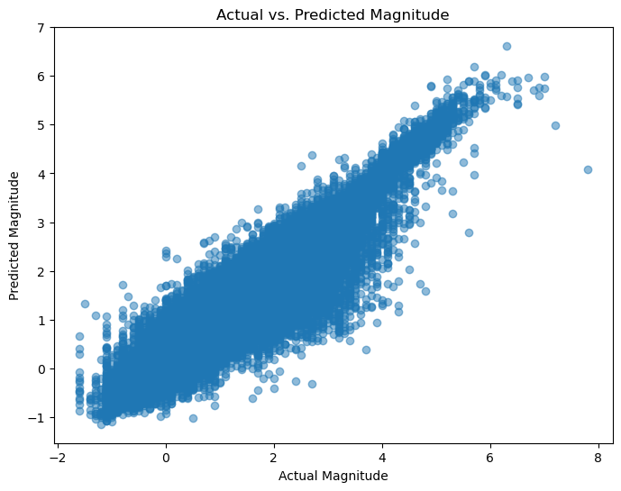
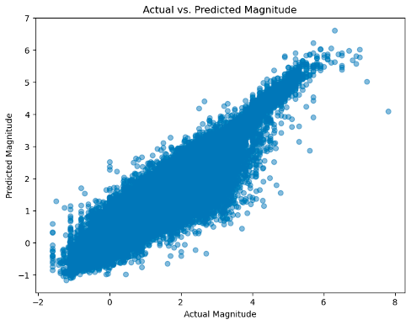
Random Forest
 | Non-Standardized | Standardized* | Standardized Rounded
Mean Squared Error | 0.1647162620097208 | 0.09028535003035057 | 0.09087754389811988
R-Squared Score | 0.7657872005933545 | 0.8559404323651552 | 0.8550296036513328
Plots
Non-Standardized
Standardized
Standardized Rounded

Slide 17
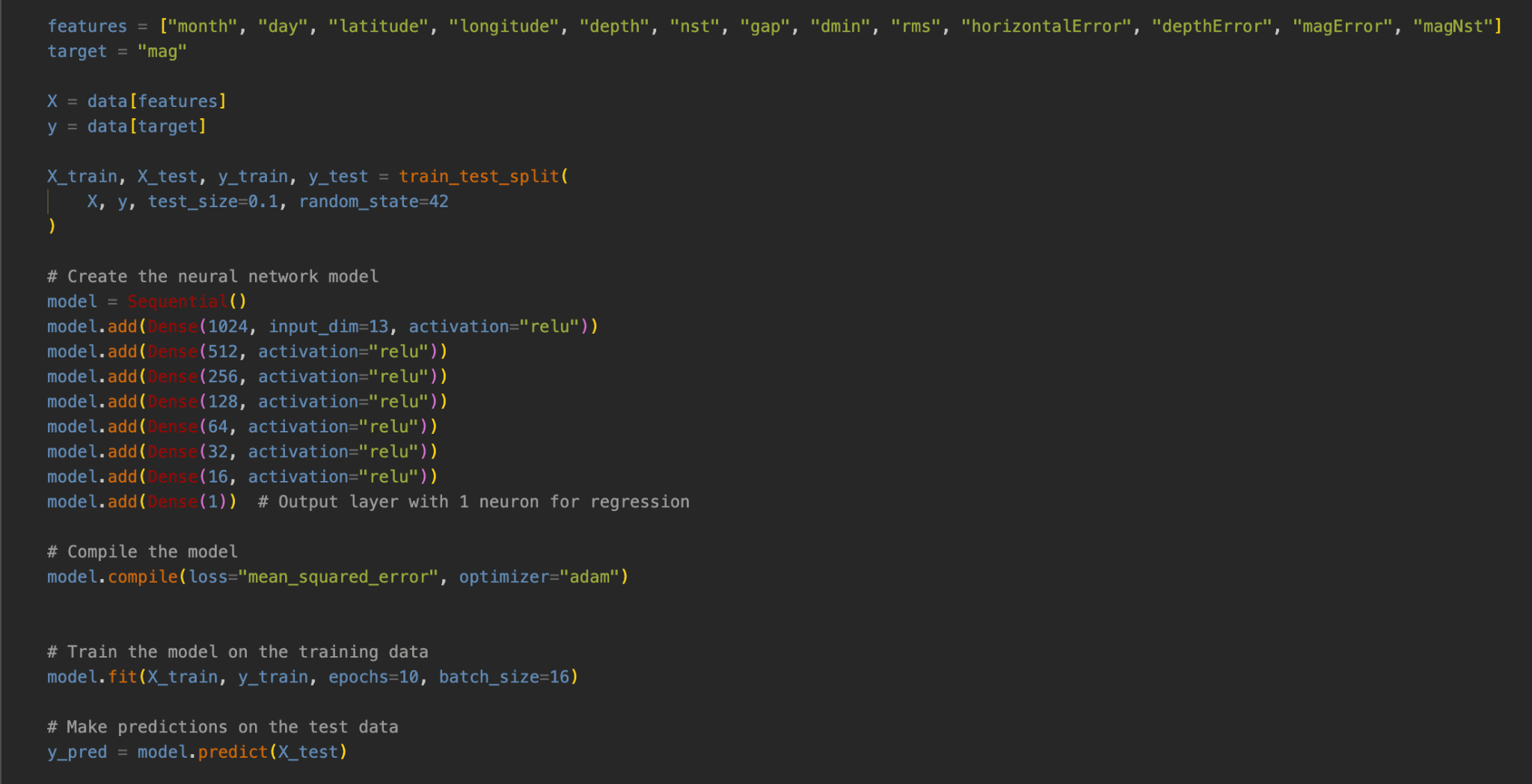
Neural Network

Slide 18

Best Neural Network
Batch Size = 16
Epochs = 50
8 Dense Layers
Test train split: 0.1
R squared: 0.81
MSE: 0.11

Slide 19
Results
 | Linear Regression | KNN | Decision Tree | Random Forest | NN
Unstandardized | 0.33 | 0.74 | 0.69 | 0.77 | 0.68
Standardized | 0.43 | 0.60 | 0.51 | 0.85 | 0.81
Standardized Rounded | 0.37 | 0.52 | 0.51 | 0.77 | 0.62

Slide 20
Conclusion
Neural Network, Random Forest performed the best
Models had better accuracy than 2/3 prior work papers
Building block for future research

Slide 21
Future Work
Experimenting further with Neural Networks
Ensemble Learning model combining Neural Network and Random Forest
Convolutional Neural Network with seismogram info as input
Reducing the number of features
Generalization

Slide 22
Questions?

Slide 23
References
[1] The United States Geological Survey. USGS.gov | Science for a changing world. (2023a, December 1). https://www.usgs.gov/
[2] Mousavi, S.M. and Beroza, G.C., 2020. A machine‐ learning approach for earthquake magnitude estimation. Geophysical Research Letters, 47(1), p.e2019GL085976.
[3] Asim, K.M., Martínez-Álvarez, F., Basit, A. et al. Earthquake magnitude prediction in Hindukush region using machine learning techniques. Nat Hazards 85, 471-486 (2017).
[4] Asencio-Cortés, G., Martínez-Álvarez, F., Troncoso, A. et al. Medium–large earthquake magnitude prediction in Tokyo with artificial neural networks. Neural Comput & Applic 28, 1043–1055 (2017). https://doi.org/10.1007/s00521-015-2121-7
[5] Analytics Vidhya. (2021, October). Everything You Need to Know About Linear Regression. https://www.analyticsvidhya.com
[6] Towards Data Science. Machine Learning Basics with the K-Nearest Neighbors Algorithm. https://towardsdatascience.com
[7] Analytics Vidhya. (2021, August). Decision Tree Algorithm. https://www.analyticsvidhya.com
[8] BuiltIn. Random Forest Algorithm. https://builtin.com/data-science/random-forest-algorithm
[9] IBM. Neural Networks. https://www.ibm.com/topics/neural-networks

